Slide 1
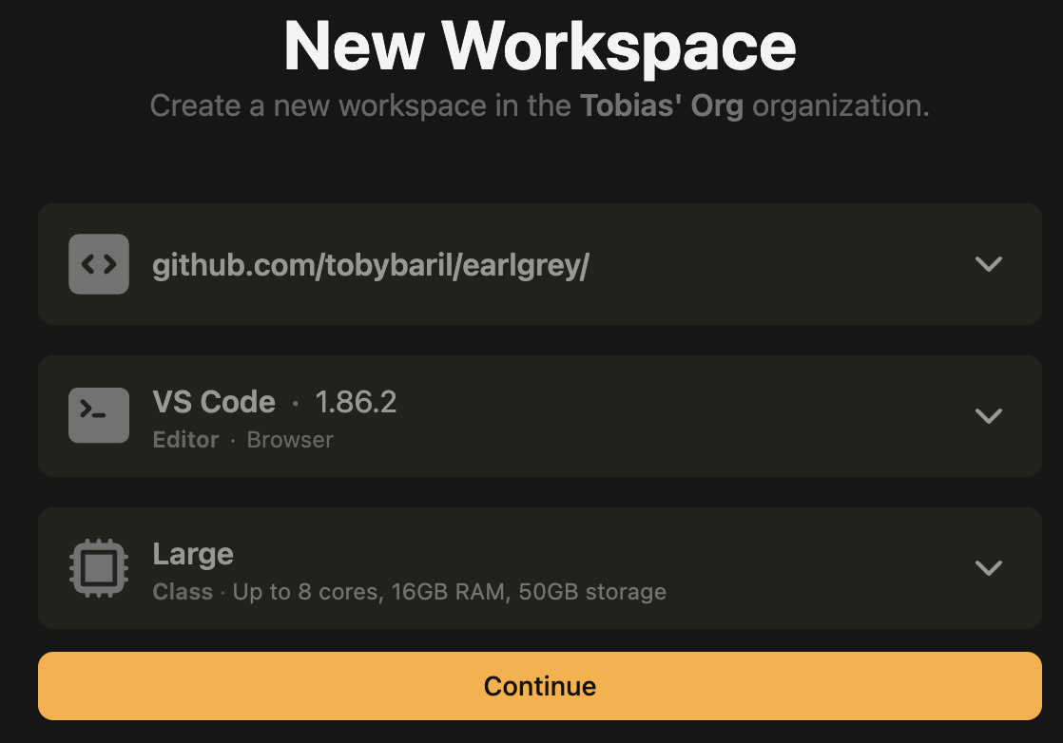
Getting Started – Please do this before the workshop
Notes:
Go To:
gitpod.io/login
Create a new workspace
Paste this https://github.com/TobyBaril/EarlGrey as the repository URL
Select large resources and continue.
The environment will configure everything and be ready in ~30 mins

Slide 2
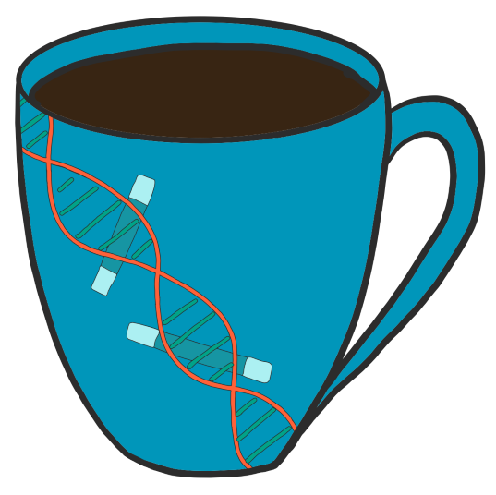

Annotating Transposable Elements with Earl Grey A Beginner’s Guide
Tobias (Toby) Baril
@tobybarilbio.bsky.social
tobybaril.github.io

Slide 3
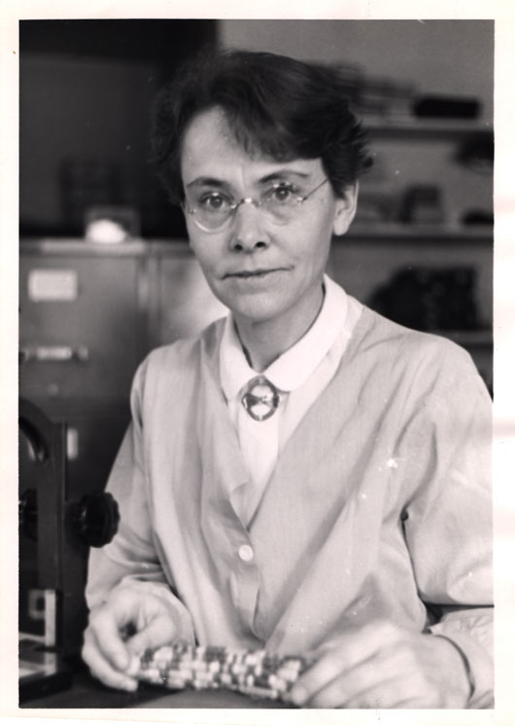
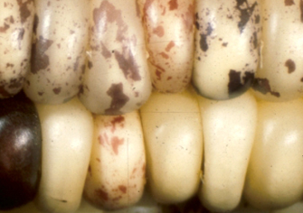
What Are Transposable Elements (TEs)?
Ds
Ds
Barbara McClintock
Nobel Prize (1983)

Slide 4
What Are Transposable Elements (TEs)?
5’
3’
Cis-regulatory
element
Transcription start site
Gene exons and introns

Slide 5
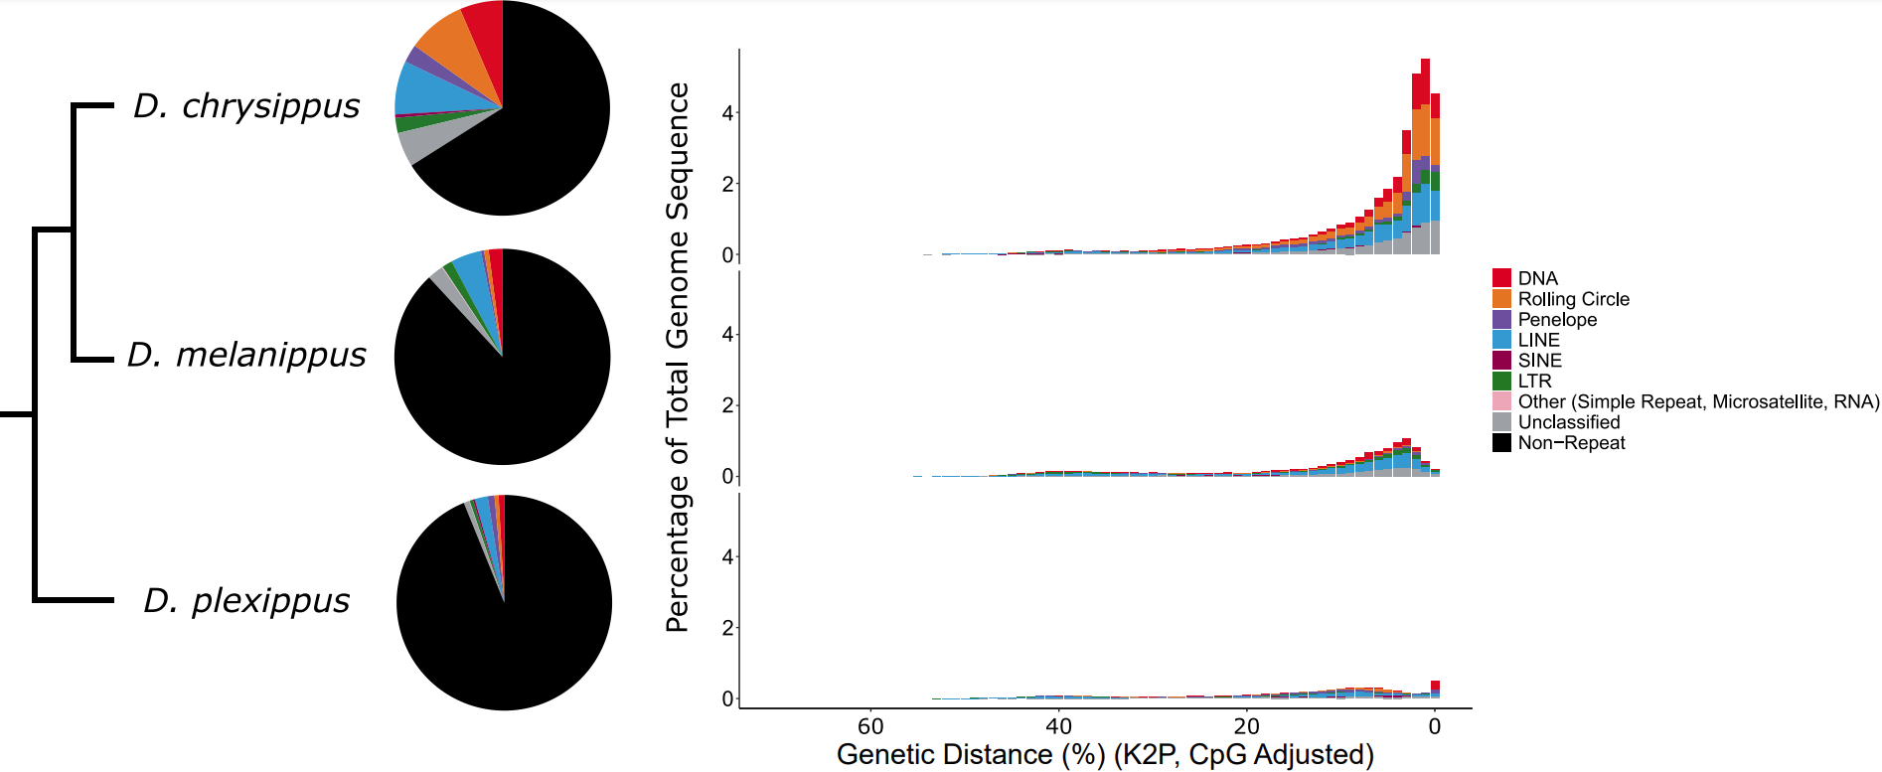
Why do we care about accurate TE annotation?
Closely related species can exhibit considerable differences in TE load
Better TE libraries enable more accurate TE prediction
Reduce presence of multi-copy genes and other host genes in databases
Reduce duplication of effort. Well-curated TE libraries facilitate scientific studies and reduce the need for reannotation

Slide 6
Why do we care about accurate TE annotation?
Closely related species can exhibit considerable differences in TE load
Better TE libraries enable more accurate TE prediction
Reduce presence of multi-copy genes and other host genes in databases
Reduce duplication of effort. Well-curated TE libraries facilitate scientific studies and reduce the need for reannotation

Slide 7
Getting Started

Slide 8
Getting Started
Genome to be annotated :
/workspace/NC_045808_EarlWorkshop.fasta
Earl Grey Command:
earlGrey –g /workspace/NC_045808_EarlWorkshop.fasta \
–s monarchDemo \
-o /workspace/ \
-t 8

Slide 9
Why make another TE annotation pipeline?

Slide 10
Why make another TE annotation pipeline?
There are over 115 TE detection tools currently available
Three main types:
Library-Based (RepeatMasker)
De-novo (RepeatModeler, RepeatModeler2, REPET)
Structure-Based (LTRHarvest, LTR-FINDER)
Most tools have been developed for specific purposes
Variable standards
“I just need to mask TEs so I can annotate genes”
“I want to accurately classify the TE repertoire in this genome”

Slide 11
Why make another TE annotation pipeline?
RepeatMasker was initially designed to improve downstream gene annotation
Paywalls!
Repbase is expensive
Dfam is improving rapidly
Issues with curation
De-novo tools face some challenges
“Unknown”
Fragmented TE annotations
A single TE annotated as n separate elements

Slide 12
The aims of Earl Grey
User-friendly to install and run
Provide install options for [most] situations
Facilitate improved automatic TE annotation
Not replacing manual curation, but trying to help close the gap
Meet the challenges of TE annotation
Define TE boundaries
Reduce TE annotation fragmentation
Not dependent on premium databases
Science for all!
Fully automated from start to finish
Multithreaded and [relatively] fast

Slide 13
What does Earl Grey do?

Slide 14
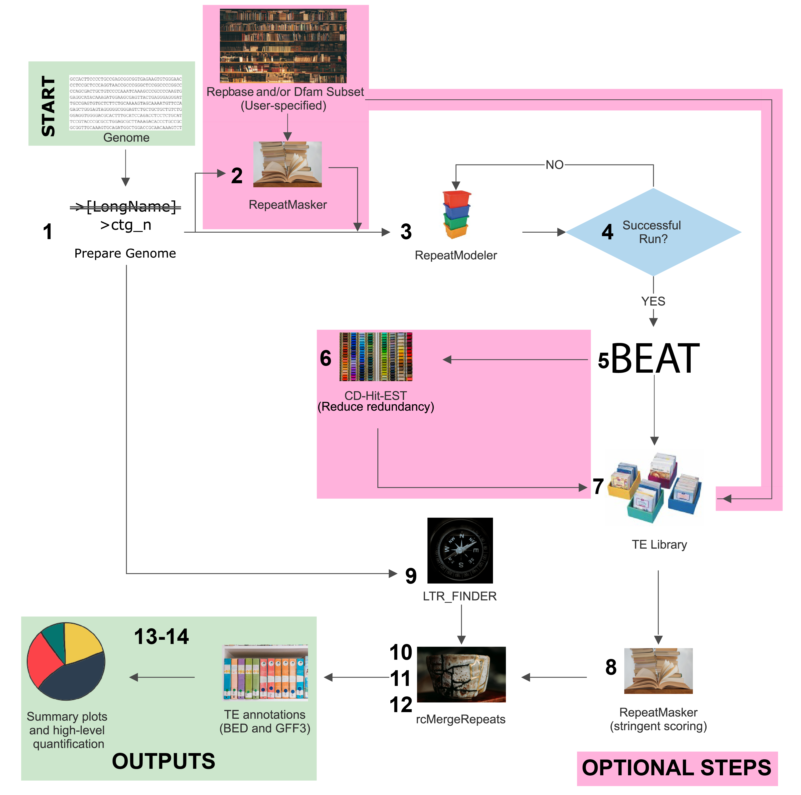
The Pipeline: An Overview

Slide 15
1. Preparation of input genome
Back up original genome fasta file
/workspace/NC_045808_EarlWorkshop.fasta.bak.gz
Replace long header names and create dictionary
>originalHeaderName123 >ctg_n
/workspace/NC_045808_EarlWorkshop.fasta.dict
Replace ambiguous IUPAC codes with N
Maintain compatibility will all tools, including RepeatMasker
/workspace/NC_045808_EarlWorkshop.fasta.prep

Slide 16
2. [OPTIONAL] Masking of known repeats
Known repeats are identified and masked in the input genome
Specified with the –r flag (e.g –r lepidoptera)
Specific with the –l flag (e.g -l /workspace/existingCustomLibrary.fasta)
Use Cases:
“I have a manually-curated library for a sister species, and I want to see what is new”
Serial annotation to gradually build a representative library
Bad Use Cases:
“I want to speed up annotation, and there is a library for this distantly related species. They must share some stuff, right?”
/workspace/monarchDemo_EarlGrey/monarchDemo_RepeatMasker/

Slide 17
3. De-novo TE Identification
RepeatModeler2 is used for de-novo TE identification
Provides the starting point on which Earl Grey aims to improve
Rate limiting step
Input:
Prepared input genome fasta (/workspace/NC_045808_EarlWorkshop.fasta.prep)
Hard-masked prepared input genome (if optional initial mask is performed)
All-by-all genome alignment to identify repetitive sequences
Output:
TE consensus library: >rnd-n_family-n#TE_Classification
/workspace/monarchDemo_EarlGrey/monarchDemo_RepeatModeler/

Slide 18
4. Verifying RepeatModeler2 runs
RepeatModeler2 can fail when annotating certain genome assemblies
E.g Drosophila melanongaster
If RepeatModeler2 is found to have finished unsuccessfully, it is restarted with a reduced stage number
Iteratively until RepeatModeler2 succeeds
/workspace/monarchDemo_EarlGrey/monarchDemo_RepeatModeler/

Slide 19
5. BEAT – Blast, Extend, Align, Trim
Implemented in the TEstrainer module of Earl Grey
BEAT
Satellite and tandem repeat detection
Reclassification of TE consensus sequences
Steps added to ensure extended consensus sequences are actually an improvement
Iterative – Sequences are recycled until no improvement can be made
/workspace/monarchDemo_EarlGrey/monarchDemo_strainer/

Slide 20
5. BEAT – BLAST, Extend, Align, Trim
Identify copies of the TE family from the input genome
BLASTN (-task dc-megablast)
Select copies >=70% pairwise identity and >=50% query coverage
Select top 20 copies based on bitscore
We want to make a nice TE consensus from the best copies we can find, as some will be more degraded than others!
Consensus Sequence
/workspace/monarchDemo_EarlGrey/monarchDemo_strainer/

Slide 21
5. BEAT – BLAST, Extend, Align, Trim
Extend flanks by 1,000bp
Create multiple sequence alignment using MAFFT
Consensus Sequence
/workspace/monarchDemo_EarlGrey/monarchDemo_strainer/

Slide 22
5. BEAT – BLAST, Extend, Align, Trim
Read columns of alignment
Discard columns with singletons
Check all sequences align to starting consensus with >=50% coverage
Construct new alignment without starting consensus sequence
Construct new extended consensus sequence
Majority rule
Consensus Sequence
/workspace/monarchDemo_EarlGrey/monarchDemo_strainer/

Slide 23
5. BEAT – BLAST, Extend, Align, Trim
New consensus sequence is aligned to starting consensus
Check that the new one still represents the original!
New consensus is shorter than original, or covers <80%
New consensus is of reduced quality, choose original consensus as final
New consensus is longer than original by <50% of flank extension size (500bp)
New consensus is complete, do not curate further
New consensus is longer than original by >50% of flank extension size (500bp)
New consensus is improved, but can be further curated. Pass to next round.
Original Consensus Sequence
New Consensus Sequence
/workspace/monarchDemo_EarlGrey/monarchDemo_strainer/

Slide 24
5. BEAT – Satellite and Tandem Repeats
Satellites and tandem repeats can be extended in several rounds
MREPS, SASSR, and TRF are used to identify satellites and tandem repeats
>50% tandem repeat = satellite / simple repeat
>200bp = macrosatellite: 1 copy extracted and saved as “satellite”
Non-tandem repeats with > 3 copies of a simple repeat at either flank are trimmed to retain 1 copy at each end
Fixes LINEs and SINEs with long satellite tails
/workspace/monarchDemo_EarlGrey/monarchDemo_strainer/

Slide 25
5. BEAT – Reclassification of TE Consensi
RepeatClassifier
Classification module from RepeatModeler2
Longer sequences should provide more information to aid classification
Reduced number of unknown sequences
Reclassified repeat library is combined with the satellite library
/workspace/monarchDemo_EarlGrey/monarchDemo_strainer/

Slide 26
6. [OPTIONAL] Reduce TE Library Redundancy
Cluster TE consensus sequences to the Wicker et al. (2007) TE family definition (80-80-80 rule)
CD-Hit-Est
80% identity over at least 80% of total length of at least 80bp
Use with caution!
This can actually hide TE families that have different evolutionary trajectories
/workspace/monarchDemo_EarlGrey/monarchDemo_Curated_Library/

Slide 27
7. [OPTIONAL] Combine TE Libraries
If an initial RepeatMasker step was performed, we need to combine the TE libraries to generate one with all sequences in
The initial library is combined with the de novo curated library to generate a final consensus set for TE annotation
/workspace/monarchDemo_EarlGrey/monarchDemo_Curated_Library/

Slide 28
8. Annotation of the Input Genome Assembly
TEs in the original input genome are identified and masked using the (now improved) TE consensus library
RepeatMasker
Sensitive search (slower but more accurate)
Will annotate all TEs that Earl Grey has curated
Potentially fragmented
Potentially missing some larger or more complex elements (e.g. LTRs)
/workspace/monarchDemo_EarlGrey/monarchDemo_RepeatMasker_Against_Custom_Library/

Slide 29
9. Identification of full-length LTRs
We want to generate the best possible automatic TE annotation for our input genome
This means we need to try and accurately identify long and complex TEs
LTR_FINDER
Looks for structural features of LTRs and stitches these together to form full-length LTR annotations
LTR
gag
IN
RT
LTR
/workspace/monarchDemo_EarlGrey/monarchDemo_mergedRepeats/

Slide 30
10-12. Repeat Defragmentation
RepeatCraft
Defragment close repeat loci to reconstruct longer TE copies
Incorporate information on full-length LTR elements
Consensus
LTR
/workspace/monarchDemo_EarlGrey/monarchDemo_mergedRepeats/looseMerge
https://github.com/niccw/repeatcraftp

Slide 31
13. Final Filtering
Resolve overlapping annotations
RepeatMasker generates some overlapping annotations
It is impossible for a single base pair to belong to multiple TEs
It is also hard to know which TE the base came from
Remove annotations <100bp
/workspace/monarchDemo_EarlGrey/monarchDemo_mergedRepeats/looseMerge

Slide 32
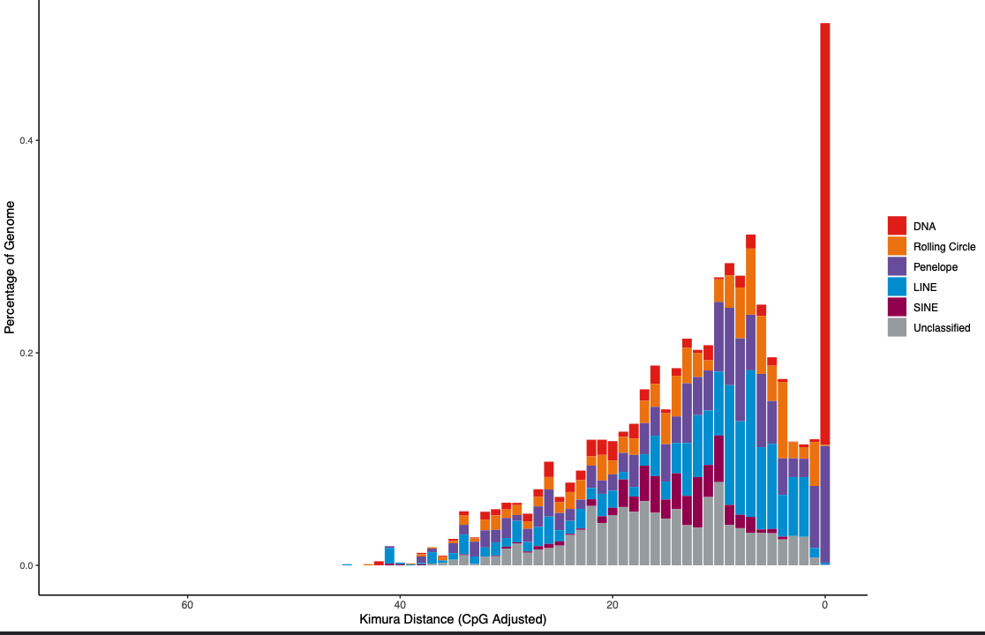
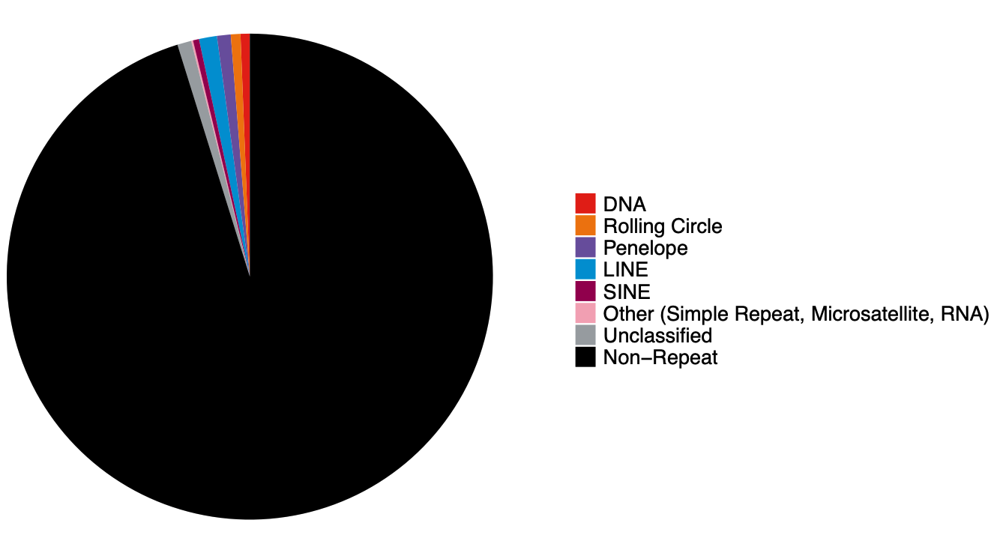
14. Summarising Results
Generate summary plots to show TE content and relative activity
/workspace/monarchDemo_EarlGrey/monarchDemo_summaryFiles/

Slide 33
14. Summarising Results
/workspace/monarchDemo_EarlGrey/monarchDemo_summaryFiles/
Improved TE consensus library – What was annotated in my input genome?
monarchDemo-families.fa.strained
Final TE annotation (GFF3 Format) – Where were the TEs in my input genome?
monarchDemo.filteredRepeats.gff
Final TE annotation (BED Format) – Where were the TEs in my input genome?
monarchDemo.filteredRepeats.bed
High-Level TE quantification – How many TEs were in my input genome?
monarchDemo.highLevelCount.txt
Family-Level TE quantification – Which were the most abundant families in my input genome?
monarchDemo.familyLevelCount.txt

Slide 34
Why is Earl Grey useful?

Slide 35
Benefits of Earl Grey
Improved performance over a raw RepeatModeler2 run
Reproducibility
Mathematical rules for consensus formation remove variability associated with human manual curation
All annotations have been treated equally, so are directly comparable
More Complete Annotations
More structural features recognisable after defragmentation
Reduced number of Unknown TE consensi
Standard Output Formats
Compatible with common downstream analysis pipelines

Slide 36
Use Cases
Annotating TEs and masking them for gene annotation
Quantifying TEs in a new genome assembly
Comparative analyses of TE content and diversity among large numbers of individuals/species
Building new species-specific TE libraries
I recommend a serial approach
Getting a head start for manual TE curation
Sequences will have been extended already, so may only require a little extra effort to perfect

Slide 37
What do I still need to be aware of?

Slide 38
We are not replacing manual curation!
Key Aim: To improve the quality of TE annotation performed by non-specialists and lower the barrier of entry to high-quality TE annotation
In most cases, TE-focused research will require manual curation
MCHelper: https://github.com/GonzalezLab/MCHelper
TE-Aid: https://github.com/clemgoub/TE-Aid

Slide 39
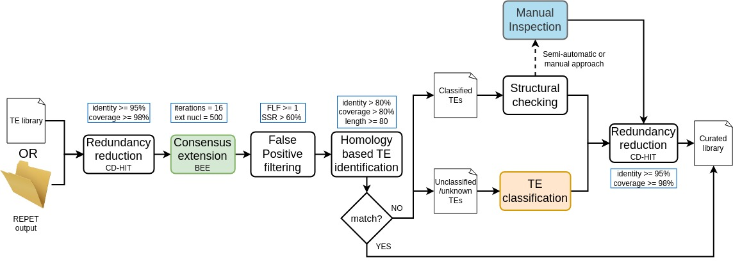
I need manual curation, how do I maintain my sanity?
Streamline
Get a priority list of sequences to curate
MCHelper will separate false positives and well-annotated sequences to give you a shortlist of candidates for manual curation
Orozco-Arias, S., Sierra, P., Durbin, R., Gonzalez, J. (2023). MCHelper automatically curates transposable element libraries across species. https://doi.org/10.1101/2023.10.17.562682. bioRxiv.

Slide 40
I need manual curation, how do I maintain my sanity?
Start at the end of Earl Grey
Sequences have already been extended, so in most cases do not need further extension
Use the help
Use TE-Aid to generate the plots and get familiar with TE features

Slide 41
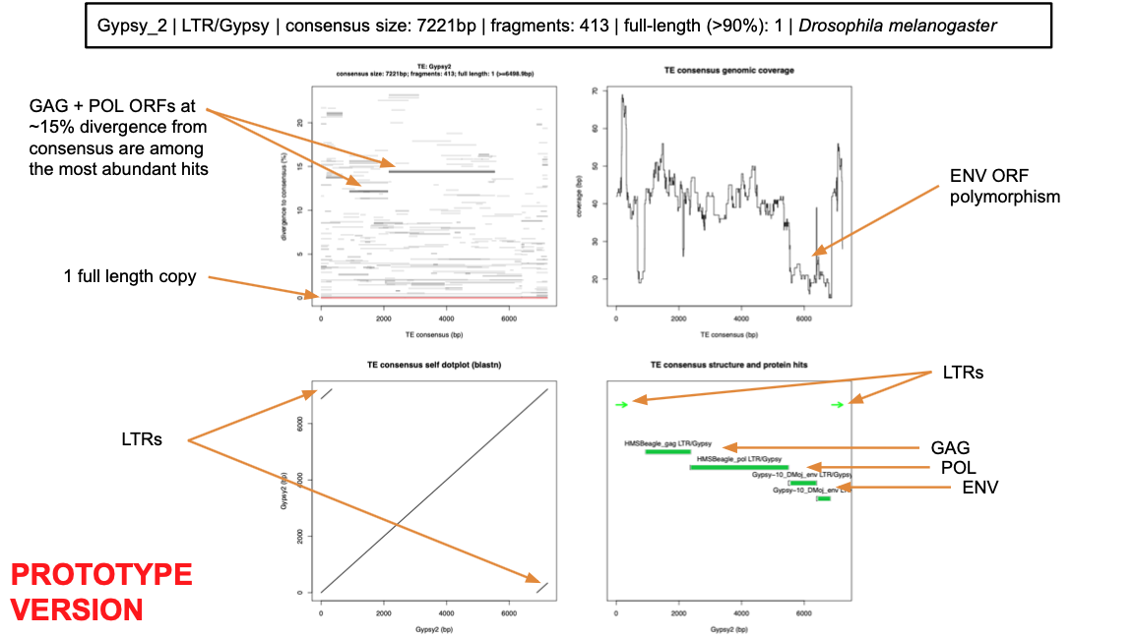
I need manual curation, how do I maintain my sanity?

Slide 42
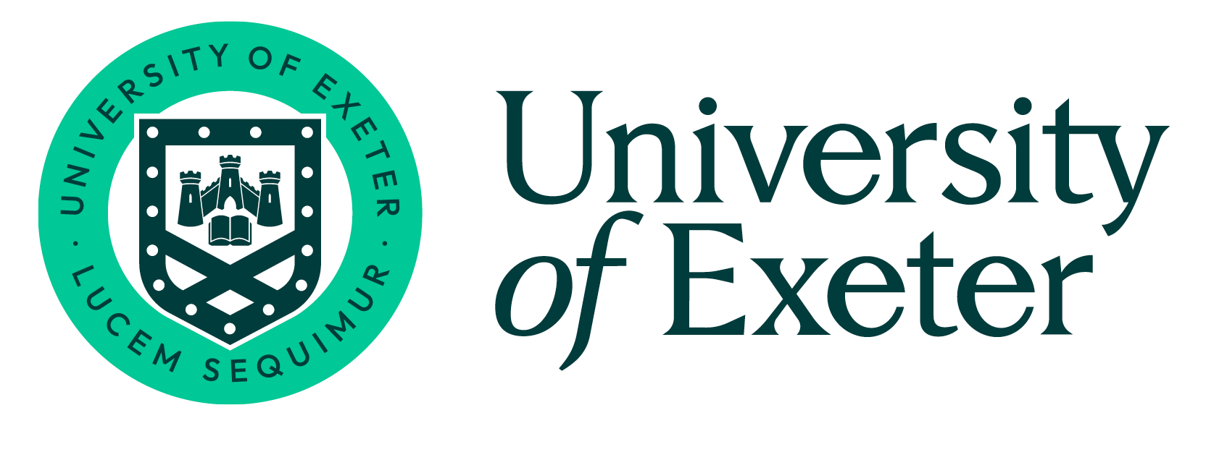


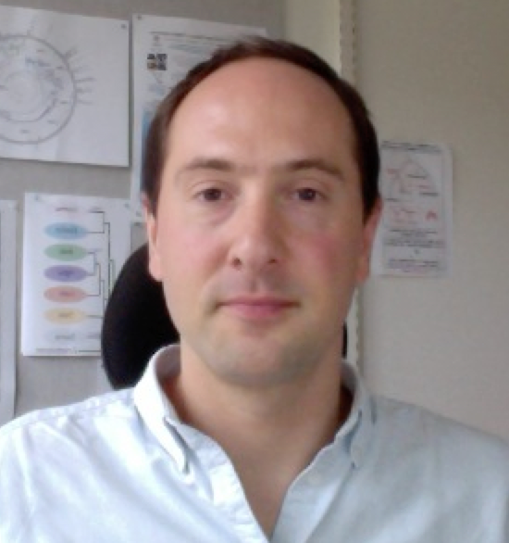




Questions?
Acknowledgements
Dr. James Galbraith
Dr. Alex Hayward
Prof. Daniel Croll
tobias.baril@unine.ch
https://github.com/TobyBaril
https://github.com/TobyBaril/EarlGrey

